Slide 1
Draft Outcome Data
Presented by Ryan Cannady

Slide 2
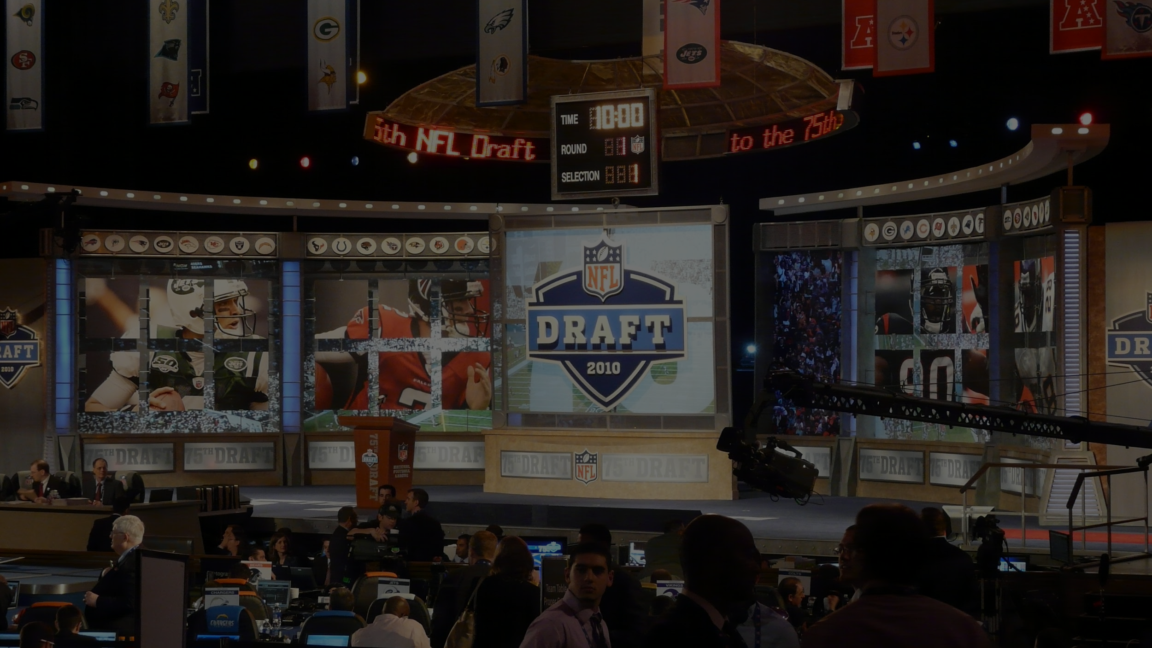
One of the most important parts of an
NFL teams success is through the draft!

Slide 3
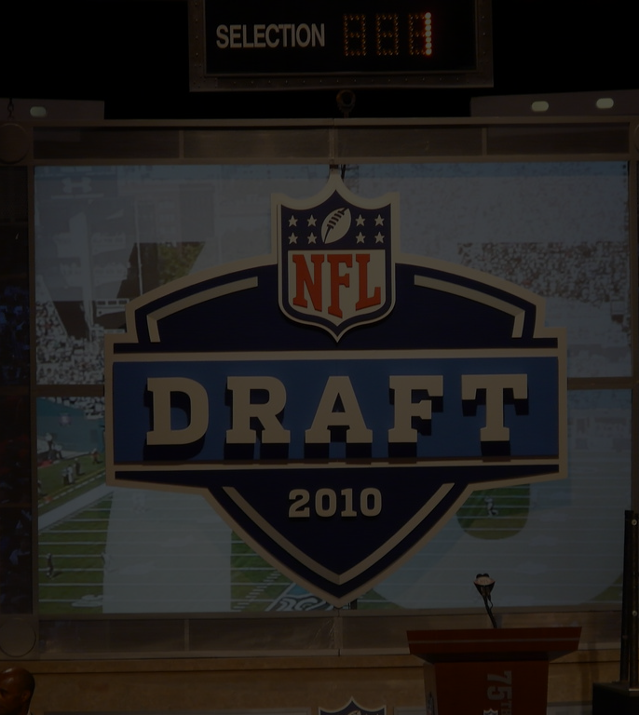
The Problem
It is very difficult to tell which players should get drafted and in what rounds.

Slide 4
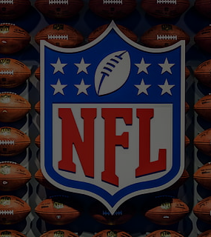
What is the solution?
I am in the process of building a model to help determine where the player should be drafted

Slide 5
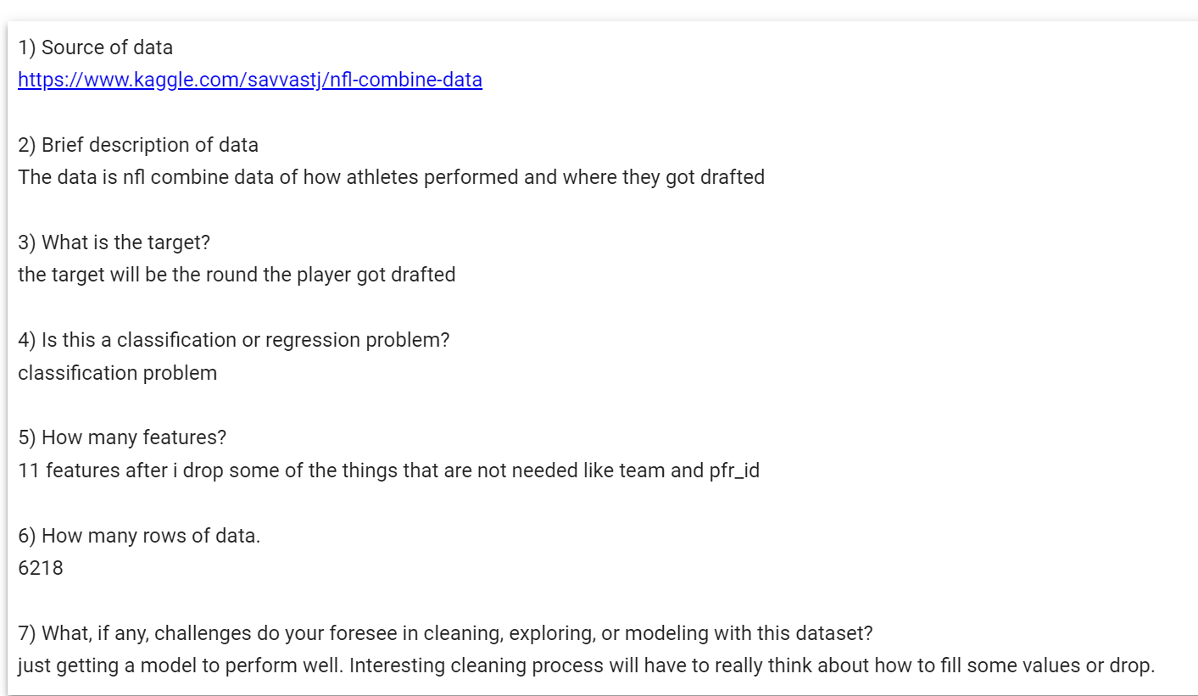
questions and answers about data

Slide 6
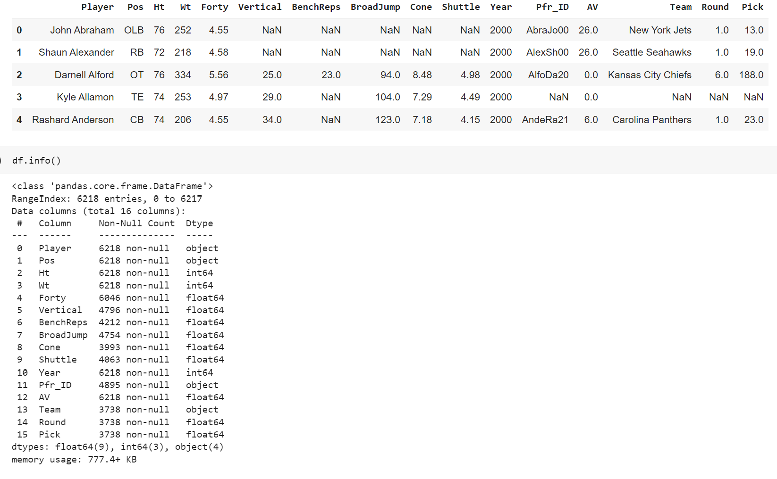

Slide 7
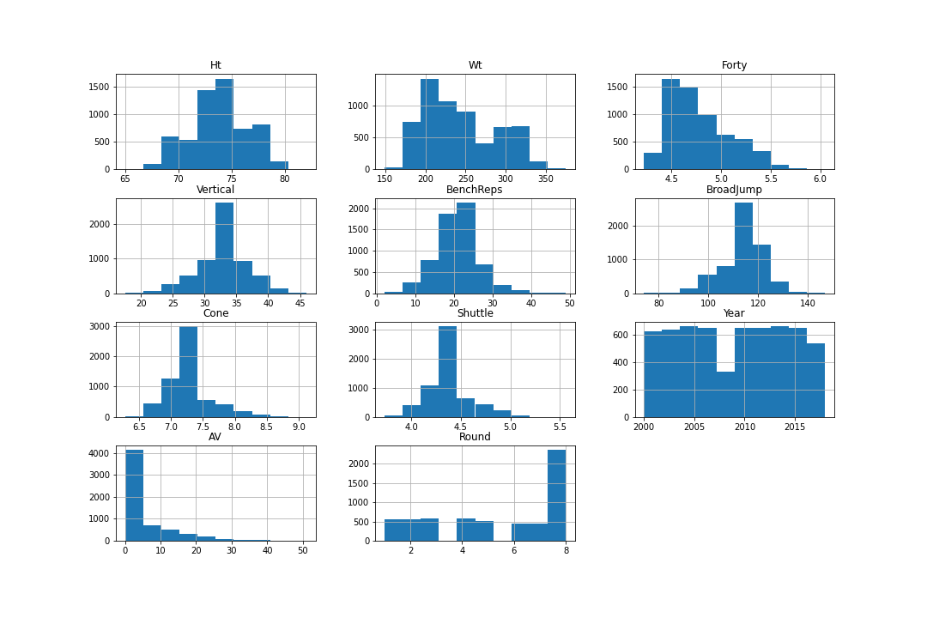
Hist plots of My Data features

Slide 8
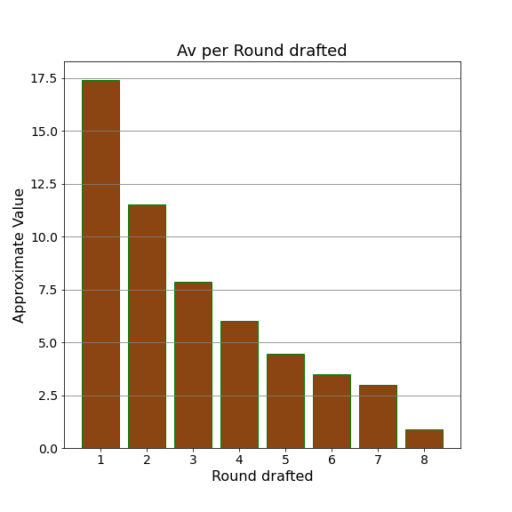
This bar graph shows
The average approximate value(AV)
Based on the round Drafted!

Slide 9
Machine Models
Path to success
Better Picks
More wins
More Revenue
With this knowledge hopefully teams will be able to make better decisions in future drafts!

